Slide 1
Condition Monitoring & Maintenance 4.0
Gears • Turbines • Engines • Hydraulic systems • Rolling and plain bearings • Special applications
Cooperation & Joint ventures
We offer a strong partner the opportunity to grow with us and jointly conquer the market for maintenance software & Industry 4.0

Slide 2



The problem: missing data & evaluations
Kooperationen
Lack of knowledge about the actual condition of machines and systems
No process monitoring options
Reactive maintenance
No use of maintenance strategies ➔ Fire department strategy!
Lack of asset management
Inadequate documentation
No maintenance controlling due to missing process data & key figures
Inadequate spare parts inventory
The unpredictable human factor on the machine, incorrect operation and manipulation
Maintenance
No Feedback

Slide 3


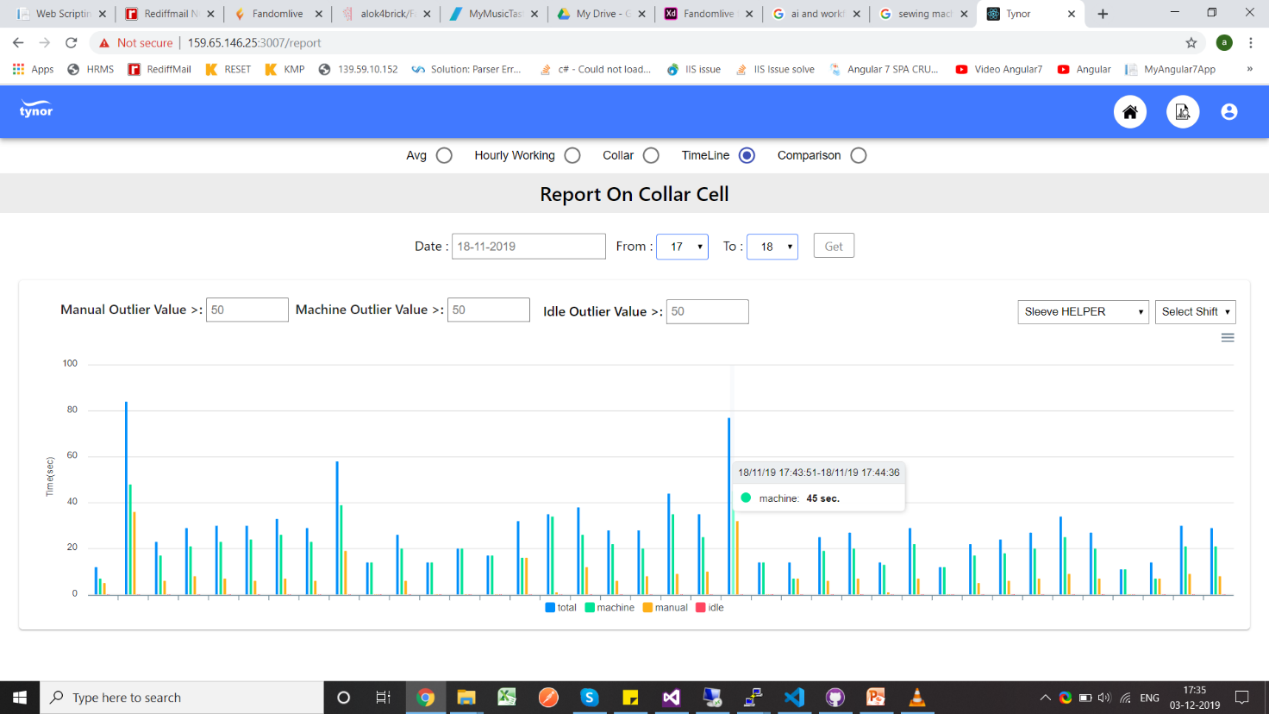





The Solution:
Kooperationen
Cooperative Maintenancemanagement
Modernization of machines and systems ➔RETROFIT
Condition Monitoring und Prozesstechnology
Artificial Intelligence und IOT
CPS-Toolbox
Maintenace controlling
Asset Management
Advice and implementation in the field of machine and operational safety
ROI Return on Invest
Elimination of faults
Condition Monitoring software
Instandhaltung
Condition Monitoring
CPS
Strategie
Asset Management
Key figures
Wear reserve
Fault messages
AI

Slide 4












The result:
Kooperationen
Perfect process understanding
Optimal availibility
Minimization of unplanned downtimes
Increase of productivity
Lower maintenance costs
Recovery of solution competence
Legally compliant machines and systems
Quality improvement
Safe machines for safe work

Slide 5
The human factor and the consequences for machines / production
Kooperationen
Incorrect operation
manipulation
sabotage
Ignorance of the processes
Reluctance to work
Missing leadership and guidelines
Easy process monitoring
Saving changes to the parameters and interventions in the existing structures
Records of differentiated handling
Detect changes by human

Slide 6


Strukturvorschlag
Kooperationen
Many more
Attention: Chance due corona crisis
Metall
Customer
Foodindustry
Waste water
Chemie
Water
Manufacturer
Automotive
Energy
Maintenance
Manufacturing and plants
Operators of critical infrastructures
Machinemanufatur Plantoperater
Organisation
Maintenance Service
Software/KI Provider
MaTeHa GmbH
Ingenieurbüro BINTEC

Slide 7
The successful implementation of requirements for maintenance 4.0 requires a change in all areas of a company. Thus, the management has to deal with the questions of whether and to what extent an exchange of data across the boundaries of the company is approved. Process and product-critical data must be transported safely and protected against unauthorized access. In turn, IT departments must be ready to introduce new mobile systems and software solutions, allow cross-plant data queries, and implement new authorization models. Furthermore, it is necessary to develop new organizations that make the necessary decisions quickly. In the opinion of all those involved, people and their competencies therefore play a very important role, indeed the most important one for "maintenance of the future". Due to the increasing complexity of maintenance and its tasks, the demand for maintenance and the employees and their qualifications are increasing. Mechatronics technicians and technicians who are well versed in mechanics, electronics and above all IT are more and more required. Human as a creative lateral thinker is the key to Industry 4.0. Humans have to evaluate the data and derive the right conclusions, only then Industry 4.o can become a success.

Slide 8
The selection of the maintenance strategy is characterized by a trend towards condition-oriented and forward-looking maintenance strategies. Condition Based Maintenance will be a new way to achieve a goal-oriented planning of maintenance tasks. The integration of intelligent sensors into the system monitoring facilitates the data acquisition and leads today to extended data provision. However, this does not always mean an improvement in the information and the associated tools to facilitate decisions. The right conclusions must be drawn and the correct diagnosis to be made. But the production of a data tsunami will not produce a cure for machines and plants. Here, the circle closes again with the man, which thanks to its adaptability and flexible way of thinking knows „its“ plants.

Slide 9
The main advantages of Predictive Maintenance from the point of view of maintenance and production are a targeted production planning, a stable utilization of the machines and the avoidance of unscheduled machine failures – reasons which help to make more and more manufacturing companies use a predictive maintenance by means of real-time data to have. The manufacturers of machines and systems are also planning a massive expansion of their range of Predictive Maintenance solutions. The VDI therefore expects a dynamic market environment in the area of ​​maintenance 4.0 within the framework of industry 4.0.

